Slide 1
STUDENT PERFORMANCE
DATA ANALYSIS SYSTEM
Transforming Student Data into Meaningful Academic Insights
Student Data
→
Analysis
→
Insights
TEAM MEMEBERS:
A.G.S.R.Kowshik(25B11CS025)
A.Anuradha(25B11CS053)
A.Yasaswini(25B11CS065)
B.Jyoshna Rani(25B11CS084)
Notes:
MEMBER 1 (Slides 1-4): Introduction & Problem

Slide 2
The Problem We Address
01
02
10,000
Student Records
Large student datasets are difficult to analyze manually.
Academic performance involves multiple attributes.
↓
Information Overload
03
04
Identifying performance patterns from raw records takes time.
Numerical data is difficult to interpret quickly without visualization.
↓
Need for Automated Analysis
Notes:
MEMBER 1

Slide 3
Our Proposed Solution
A Python-based Student Performance Data Analysis System that converts raw student records into structured academic insights.
01
→
02
→
03
→
04
Raw Dataset
Data Inspection
Data Cleaning
Data Processing
05
→
06
→
07
→
08
Statistical Analysis
Grade Classification
Visualization
Insights
Notes:
MEMBER 1

Slide 4
Project Objectives
01
02
03
04
05
Data Management
Data Cleaning
Performance Analysis
Student Classification
Visual Insights
Manage and analyze student records efficiently.
Handle missing and inconsistent values.
Calculate totals, averages and statistical measures.
Assign grades and identify performance categories.
Represent academic patterns through graphs.
Notes:
MEMBER 1

Slide 5
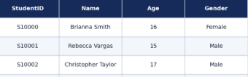
Understanding Our Dataset
10,000
[ Insert real DataFrame preview
screenshot – df.head() ]
Student Records
14
Student Information
Academic Information
Additional Information
StudentID
Name
Age
Gender
Class
Math
Science
English
History
Computer
AttendancePercent
Extracurricular
Total
Grade
Features
Notes:
MEMBER 2 (Slides 5-8): Dataset & Methodology

Slide 6
Technology & Tools
Python
Pandas
NumPy
Matplotlib
Google Colab
Core programming language
Data manipulation and analysis
Numerical and statistical operations
Data visualization
Development environment
CSV Dataset
→
Python Analysis
→
Visual Insights
Notes:
MEMBER 2

Slide 7
From Raw Data to Academic Insights
Data Inspection
Preprocessing
Grade Classification
Insights
1
2
3
4
5
6
7
8
Student Dataset
Data Cleaning
Statistical Analysis
Visualization
Notes:
MEMBER 2

Slide 8
Preparing the Data for Reliable Analysis
01
Missing Value Detection
1,652
02
Missing Value Handling
Missing Extracurricular Values
03
Text Cleaning
↓
“Not Specified”
04
Numeric Conversion
0
05
Marks & Attendance Validation
Duplicate Records
06
Total & Average Calculation
Raw Data → Clean Data
Notes:
MEMBER 2

Slide 9
Turning Marks into Meaningful Metrics
64.38
64.00
20.17
Grade Classification
A+
≥ 90
Overall Mean
Median
Standard Deviation
A
≥ 80
B
≥ 70
99
30
C
≥ 60
D
≥ 50
Highest Mark
Lowest Mark
F
< 50
Notes:
MEMBER 3 (Slides 9-13): Analysis, Visualization & Results

Slide 10
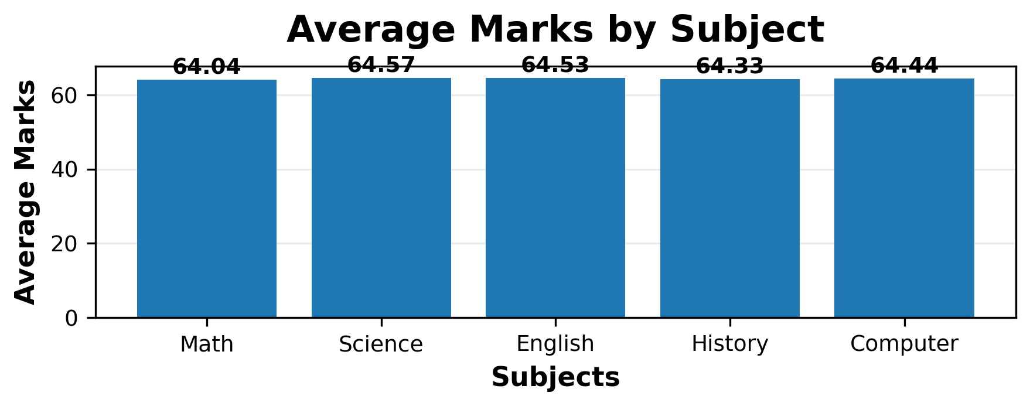
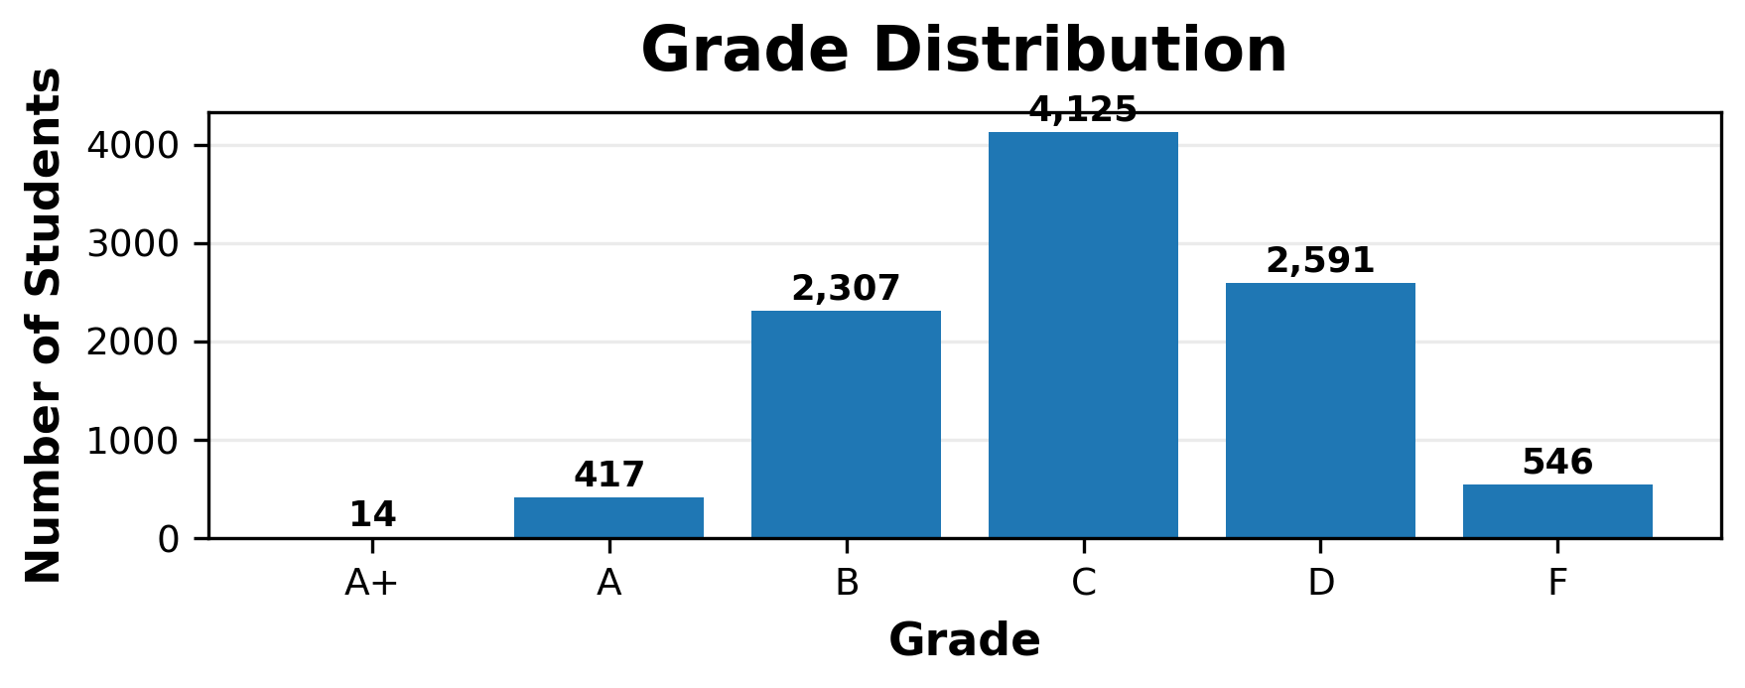
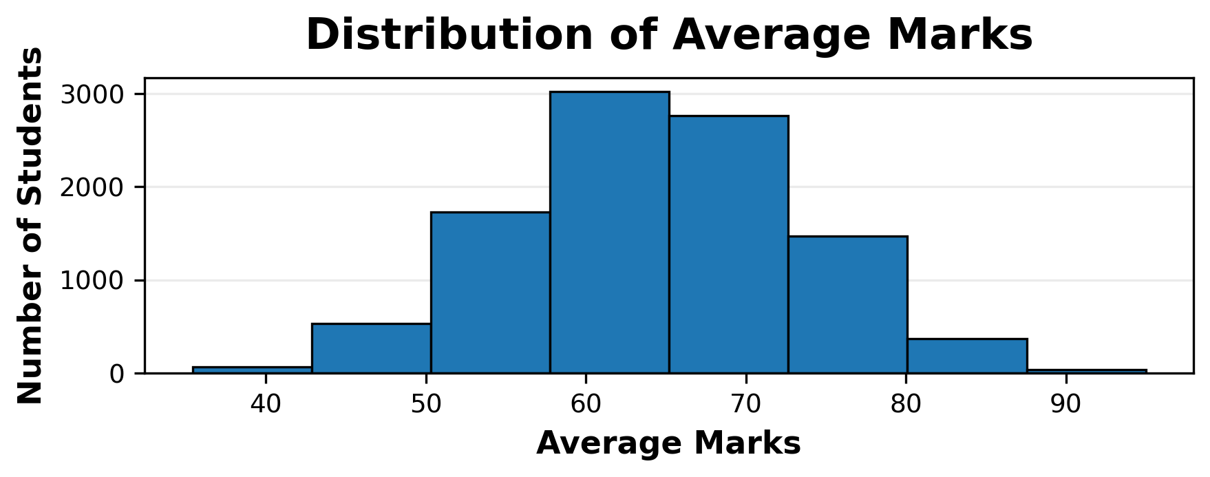
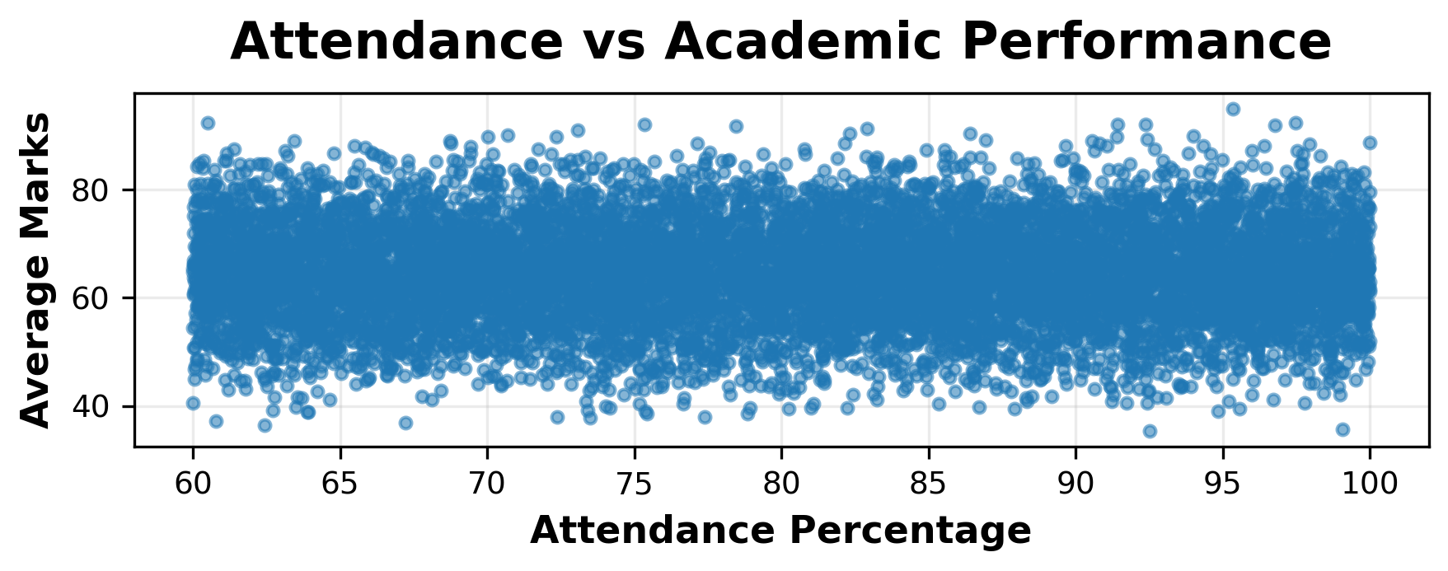
Visualizing Student Performance
Average Marks by Subject
Grade Distribution
Distribution of Average Marks
Attendance vs Academic Performance

Slide 11
What Did We Discover?
10,000
64.38
99.75%
546
Students Analyzed
Overall Average
Pass Percentage
Students with Average < 50
64.57
64.04
95.0
Science – Highest Subject Average
Math – Lowest Subject Average
Highest Individual Average
Notes:
MEMBER 3

Slide 12
From Raw Data to Meaningful Insights
CONCLUSION
FUTURE SCOPE
Our system transforms raw student records into structured academic insights through:
Interactive dashboard
Predictive performance analysis
Advanced student segmentation
Early academic-support alerts
Institutional database integration
Cleaning → Analysis → Classification → Visualization
RAW DATA → SMART ANALYSIS → ACTIONABLE INSIGHTS
Thank You
Notes:
MEMBER 3

Slide 13
Now Let’s See How It Works…
Live code demonstration in Google Colab
Notes:
Transition: switch to Google Colab live demo

